Slide 1
Punctuation Marks - English VS Spanish
Dalenys Alonzo.

Slide 2
What are Punctuation marks?
Punctuation marks are symbols that are used in sentences and phrases to make the meaning clearer. Some punctuation marks are the period (.), comma (,), question mark (?), exclamation point (!), colon (:) and semicolon(;)

Slide 3
Why to use them?
To show how a sentence is constructed and how it should be read, we need the punctuation marks.
What you write is interpreted by others.

Slide 4
The Comma (,)
The comma is useful in a sentence when the writer wishes to:
Pause before proceeding
Add a phrase that does not contain any new subject
Separate items on a list
Use more than one adjective (a describing word, like beautiful)

Slide 5
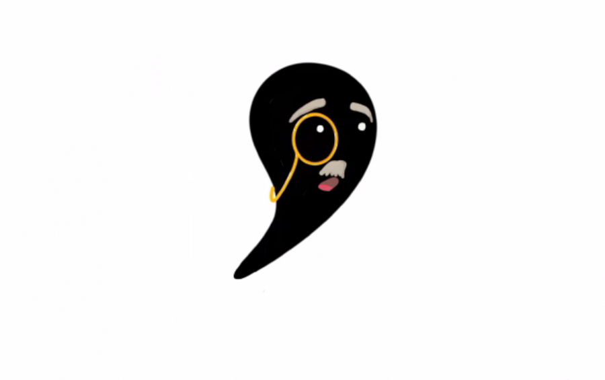
The Oxford Comma
In American English, write a comma before "and" and "or" when enumerating three of more items. In Spanish, don't. The Oxford (or "serial") comma doesn't exist in Spanish.
English | Spanish
This explanation is short, concise, and clear. | Esta explicación es corta, concisa y clara.
You can study Spanish with a friend, classmate, or family member. | Puedes estudiar inglés con amigos, compañeros de clases o familiares.

Slide 6
Period or Full Stop (.)
A full stop should always be used to end a sentence. The full stop indicates that a point has been made and that you are about to move on to further explanations or a related point.
Less frequently, a series of three full stops (an ellipsis) can be used to indicate where a section of a quotation has been omitted when it is not relevant to the text, for example:
“The boy was happy… at the start of his summer holiday.”

Slide 7
Exclamation Mark (!)
An exclamation mark indicates strong feeling within a sentence, such as fear, anger, surprise, or love. It is also used to accentuate feeling within the written spoken word.
In this way, it can also be used to indicate a sharp instruction, or to indicate humor.

Slide 8
Exclamation Mark (!)
The exclamation mark at the end of a sentence means that you do not need a full stop.
Exclamation marks are a poor way of emphasising what you think are important points in your written assignments; the importance of the point will emphasise itself without a sequence of !!! in the text. An exclamation mark should only be used when absolutely essential, or when taken from a direct quote.
The exclamation mark should be used sparingly in formal and semi-formal writing.

Slide 9
Question Mark (?)
The question mark simply indicates that a sentence is asking a question. It always comes at the end of a sentence:
Are you still with me?
What’s your name?
How are you?

Slide 10
English vs. Spanish
Questions Marks and Exclamation Points:
In English, write one mark/point at the end of the question/exclamation only. In Spanish, start the question/exclamation with an inverted mark, and close it with a question exclamation mark.
English | Spanish
Who wrote this? | ¿Quién escribió esto?
This explanation is so cool! | ¡Esta explicación está genial!

